Slide 1
Dota 2 Champion Select
By: Jeffrey Walls and Ethan Smith

Slide 2
Our Model
K-Nearest Neighbors (KNN)
For each champion missing in a team add 1 to the difference

Slide 3
Dataset
102944 Matches
113 Different Champions each either a 1 for blue team, -1 for red team, or 0 if they weren’t played in that match
Released August 13th, 2016
Collected using
https://gist.github.com/da-steve101/1a7ae319448db431715bd75391a66e1b

Slide 4
Data Cleansing
Columns 2, 3, and 4 had irrelevant data regarding the location, game mode, and whether the match was ranked or not
Multiplied the columns from 5+ by the winner of the match and removed the first 5 columns to get the winning comp and the losing comp

Slide 5
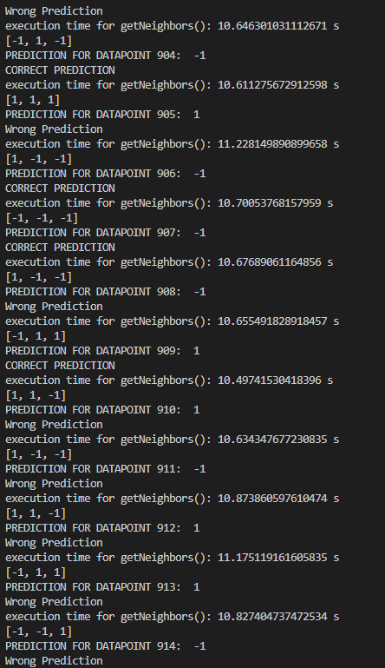
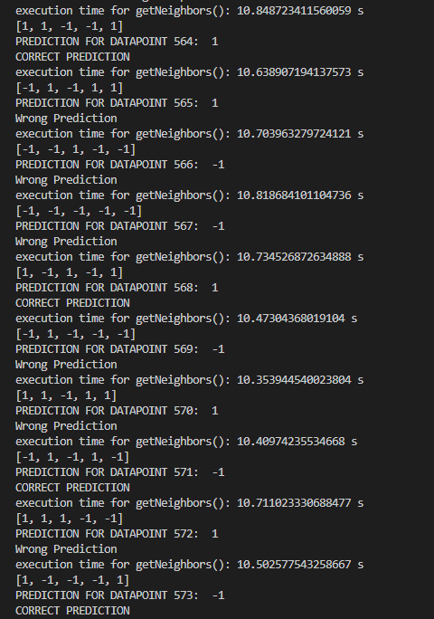
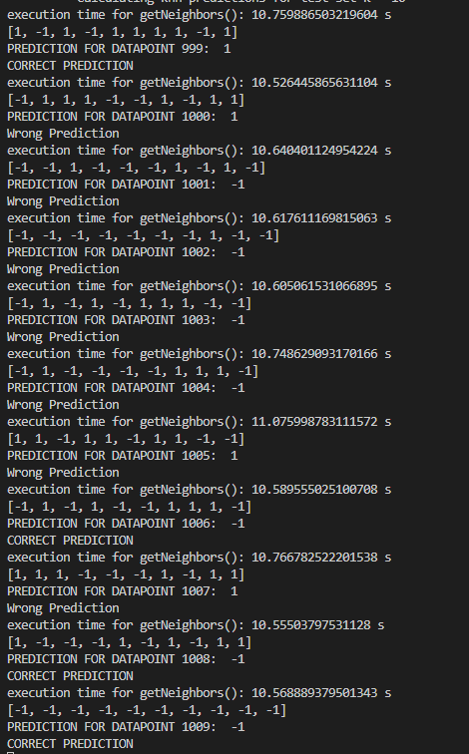
Results

Slide 6
Improvements
Different distance for each role that was changed

Slide 7
References

Slide 8
Thank You

